Slide 1

ScreenSense : Kids’ Screentime Visualization
Presented by:
PRABAKARAN.N

Slide 2
PROJECT DESCRIPTION
This project analyzes screen-time patterns among Indian children using data visualization and dashboarding techniques. By examining how age groups, device types, usage purpose, location, and habits influence screen exposure, the study identifies high-risk cohorts and unhealthy digital behaviors. Interactive visualizations and KPI indicators are designed to help parents, teachers, and policymakers understand screen-time risks and promote balanced digital usage.

Slide 3
OBJECTIVE
The objective of this project is to analyze screen-time patterns among Indian children to identify usage trends across age groups, devices, and demographics.
The study aims to detect high-risk cohorts by examining factors such as screen-time intensity, device dependency, and health impacts.
The final goal is to support awareness, data-driven decision-making, and healthier digital habits among children and adolescents.

Slide 4
DATASET OVEREVIEW
The project uses the Indian Kids Screentime 2025 dataset, sourced from Kaggle. The dataset contains 9,712 records and 8 key attributes, capturing demographic details and screen-usage behavior of children. The main fields include Age, Gender, Average Daily Screen Time (hours), Primary Device, Exceeded Recommended Limit, Health Impacts, Educational-to-Recreational Ratio, and Urban/Rural classification.

Slide 5
MILESTONE 01: Data Foundation and Cleaning
WEEK 01
In Week 1, the focus was on establishing a strong data foundation for the entire project. The dataset was loaded, inspected, and validated to understand its structure, quality, and readiness for analysis. Key tasks included reviewing columns, identifying missing or inconsistent values, understanding data types, and documenting assumptions. This baseline ensured that all future visualizations and dashboards were built on clean, reliable, and well-structured data.
Functions Used
pandas : df=pd.read_csv() – Dataset loading
df.head() – Preview dataset
df.info() – Check data types & null values
df.shape – Dataset size
df.describe() – Summary statistics
df.isnull().sum() – Missing value detection
df.nunique() – Unique value analysis

Slide 6
WEEK 02
The focus shifted from data understanding to data preparation. The objective was to clean the dataset, handle missing and inconsistent values, and engineer meaningful features that would enable accurate analysis and effective dashboard visualization in later milestones.
Data Cleaning & Preprocessing
Identified missing values mainly in the Health Impacts column.
Imputed missing health impacts using Avg Daily Screen Time hr similarity logic.
Applied nearest screen-time range matching when exact
Feature Engineering (Derived Columns Created)
Age Group → Child / Early Teen / Teen
Screen Time Level → Low / Medium / High / Very High
Edu vs Rec → Education Dominant / Recreational Dominant / Balanced
Health Impact Count → Numeric count of reported health issues(n)
Device Category → Mobile / Laptop / TV (grouped device logic)

Slide 7
Milestone 02: Visual Exploration and Topic Trends
WEEK 03
The focus was on understanding the overall behavioral patterns in the dataset by exploring individual variables (univariate analysis) and then examining relationships between two variables (bivariate analysis).By combining simple distribution charts with comparative visuals, I identified how age, gender, location, device preference, and purpose of usage influence screen-time levels and health-related impacts. This week built the analytical base required for deeper cohort and habit analysis in later milestones.
Univariate Charts
Bivariate Chart
Age Group distribution
Gender distribution
Primary Device distribution
Avg Daily Screen Time hr distribution
Exceeded Recommended Limit count
Health Impact Count distribution
Screen Time Level distribution
Edu vs Rec distribution
Age Group vs Avg Daily Screen Time hr Gender distribution
Gender vs Avg Daily Screen Time hr
Primary Device vs Avg Daily Screen Time hr
Urban or Rural vs Avg Daily Screen Time hr
Primary Device vs Health Impact Count
Edu vs Rec vs Health Impact Count
Urban or Rural vs Exceeded Recommended Limit
Screen Time Level vs Exceeded Recommended Limit

Slide 8
WEEK 04
The objective of Week 4 was to analyze how device usage, activity purpose (educational vs recreational), and time patterns (weekday vs weekend) influence children’s screen-time behavior. Power BI was used to create interactive visuals to identify peak-usage cohorts and behavioral differences across demographics.
Derived Columns
For weekday vs weekend analysis, a derived column Day Type was created using usage behavior
Educational Dominant → Weekday
Recreational / Balanced → Weekend
Charts Created & Analysis
Device Category vs Avg Screen Time
Age Group vs Primary Device
Device Category vs Health Impact Count
Gender vs Device Category
Urban or Rural vs Device Category
Edu vs Rec vs Screen Time Level
Weekday vs Weekend Screen Time
Age Group vs Weekend/Weekday screen time

Slide 9
Milestone 3: Segment & Insight Deep-Dives
WEEK 05
The objective of Week 5 was to perform cohort and segment analysis to understand how children’s screen-time behavior varies across key demographic and behavioral groups. This phase focused on identifying high-risk cohorts by combining factors such as age group, device usage, activity purpose, and location type. By segmenting users into meaningful groups, deeper insights were derived about which combinations contribute most to high and excessive screen time. The analysis helped move beyond general trends to group-specific behavioral patterns. These insights support targeted awareness and intervention strategies for parents and educators.
Cohort & Segment Analysis:
Age Group × Device Category
Urban or Rural × Screen Time Level
Age Group × Edu vs Rec

Slide 10
WEEK 06
The objective of Week 6 was to analyze habit-based screen-time patterns in the absence of detailed date or seasonal information. This week focused on understanding how screen usage behavior differs based on routine factors, such as weekdays versus weekends and device dependence. Behavioral summaries were supported using key performance indicators to capture overall risk severity and over-usage intensity. The goal was to identify behavioral drivers behind excessive screen time rather than isolated metrics. This helped convert segmented findings into actionable habit insights.
Habit Patterns:
KPI-based Habit insights
Weekday vs Weekend Avg Screen Time
Screen Time Level × Device Category
Avg Screen Time (hrs.)
Pct Above Limit (Percentage Above Safe Limit)
Most Used Device
Top Cohort Name & Hrs.
Count High & Very High

Slide 11

Milestone 4: Report and Presentation
Week 07
Screen Sense Kids’ Screentime Visualization Presentation
In This Week focuses on transforming analytical findings into an intuitive and well-structured interface that can be easily understood by parents, teachers, and non-technical stakeholders. Emphasis is placed on logical visual flow, consistent layout, and effective use of filters to enable focused exploration across age groups, gender, device usage, and location type. Proper titles, legends, labels, and interaction controls are applied to ensure clarity and interpretability. The outcome of this week is a professional, decision-ready dashboard that communicates key screen-time patterns and risk indicators effectively.

Slide 12
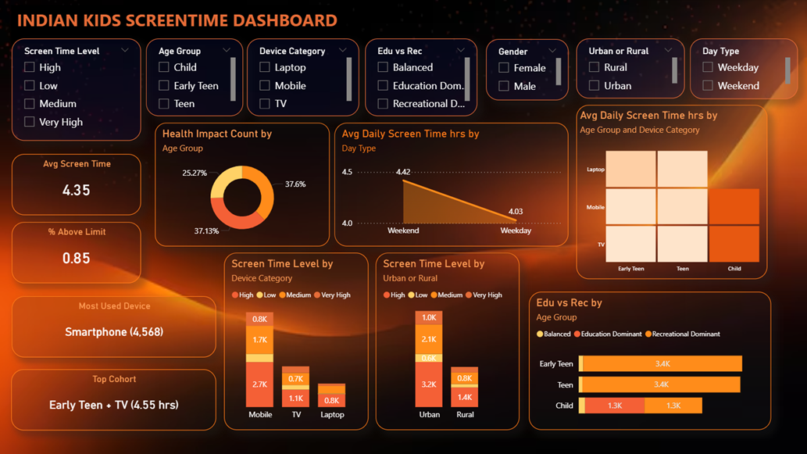
ScreenSense : Kids’ Screentime Visualization
DASHBOARD

Slide 13
WEEK 08
The objective of Week 8 was to formally document the project findings and present them in a professional format. This included preparing a final written report, creating a structured slide deck, and providing a walkthrough of dashboard insights and interactions. The aim was to clearly communicate analysis results, behavioral insights, and conclusions to non-technical stakeholders using well-organized documentation and visual storytelling.

Slide 14

Thank You

